Slide 1
Solar Panel Maintenance System
Based on Artificial
Intelligence

Slide 2
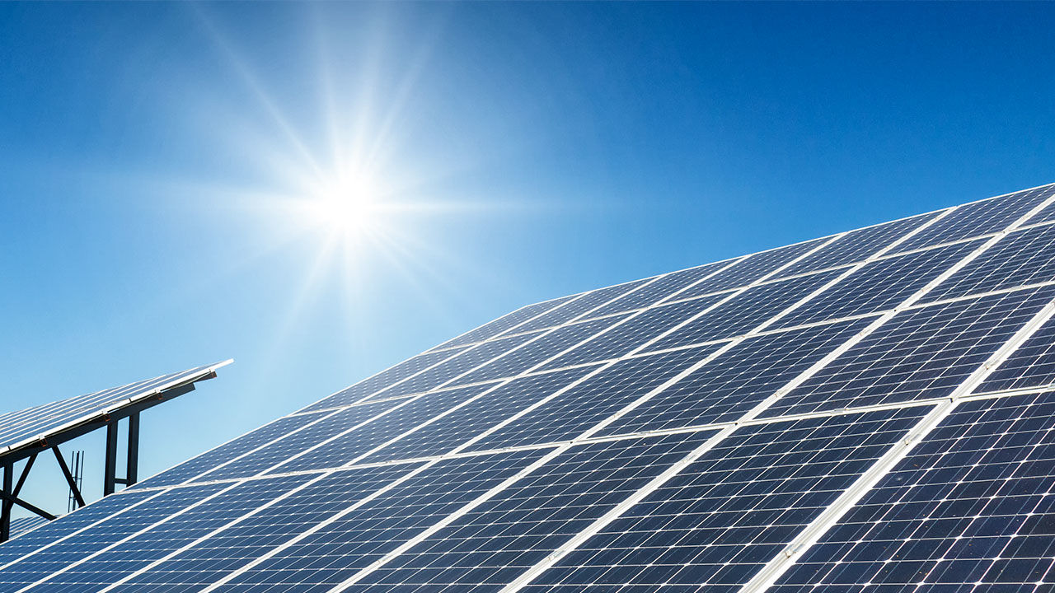
INTRODUCTION
The system will consist of two major components ->
1 – Software
2 – Hardware

Slide 3
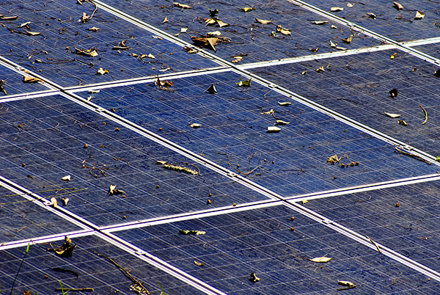
SOFTWARE
Will be used to receive, maintain and process data from the sensors
The software will be made in python.
It will be connected to hardware with a local Wi-Fi.
It will consist of a Neural Network.
The raw data from the hardware will be fed to the Neural Network and it will instruct the hardware to do a particular task only if needed.
The software will manage data over an online database.

Slide 4
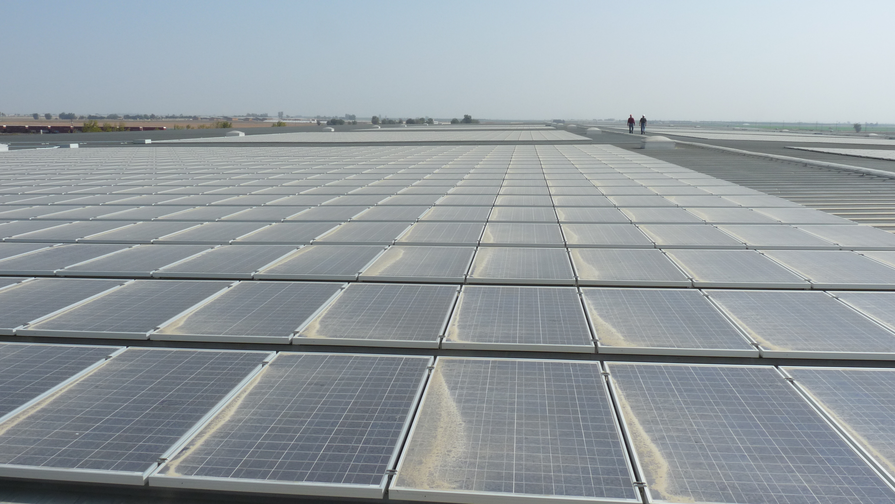
HARDWARE
This will collect and transmit data from various data sensors.
Also will clean the Solar panels
The main part of the hardware will be a microcontroller..
It will consist of various sensors to collect all sort of valuable data. Like, temperature, humidity, amount of sunlight, rainfall, wind direction, wind speed etc.
It will also contain a water jet and a wind blower in order to clean the solar panel.
It will transmit all the sensor data to software over a local Wi-Fi connection.

Slide 5
WORKING
STEP 1 – Collection of real time data from the sensors in the hardware.
STEP 2 – Transmission of collected data from hardware over Local Wi-Fi network to the software and to the online database.
STEP 3 – Receiving data by software over local Wi-Fi from the hardware.
STEP 4 – Conversion of raw date received into system understandable form.
STEP 5 – Feeding the converted data to the well trained neural network.
STEP 6 – Processing in the neural network.
STEP 7 – Collection of Output from the neural network.
STEP 8 – Search for the action based on received data.
STEP 9 – Selection of most suited set of instructions from database.
STEP 10 – Transmitting the set of selected instruction to hardware over local Wi-Fi.
STEP 11 – Receiving instructions by hardware over local Wi-Fi from the software.
STEP 11 – Processing the received instructions.
STEP 12 – Implementation of instruction by hardware.

Slide 6
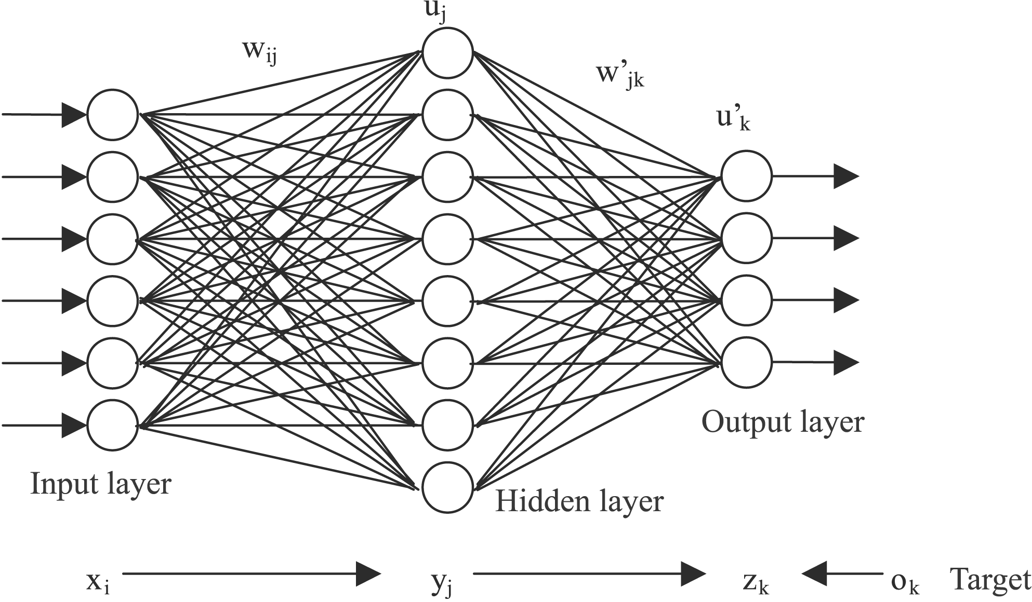
NEURAL NETWORK
Multilayer Perceptron(MLP) Neural Network is used and will be trained in supervised learning algorithm.
MLP type of neural network is best suited for this system because of enormous amount of input data and complex processing.

Slide 7
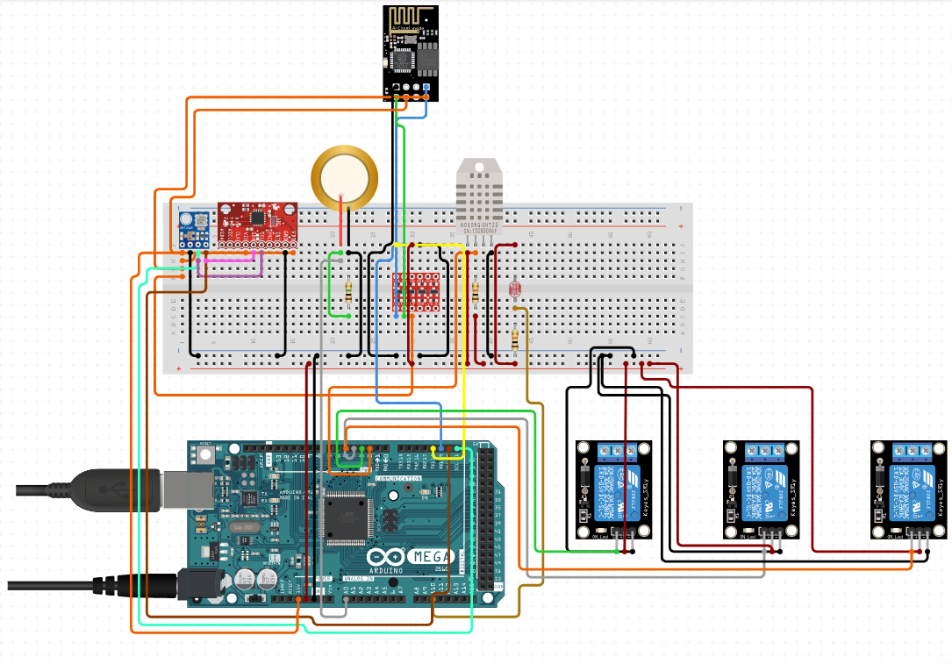
HARDWARE UNIT
It will consist of ->
Microcontroller
Wi-Fi Module
Gyroscope
Humidity Sensor
Photo Sensor
Rain Sensor
Barometer
Anemometer
Water Jet
Air Blower

Slide 8
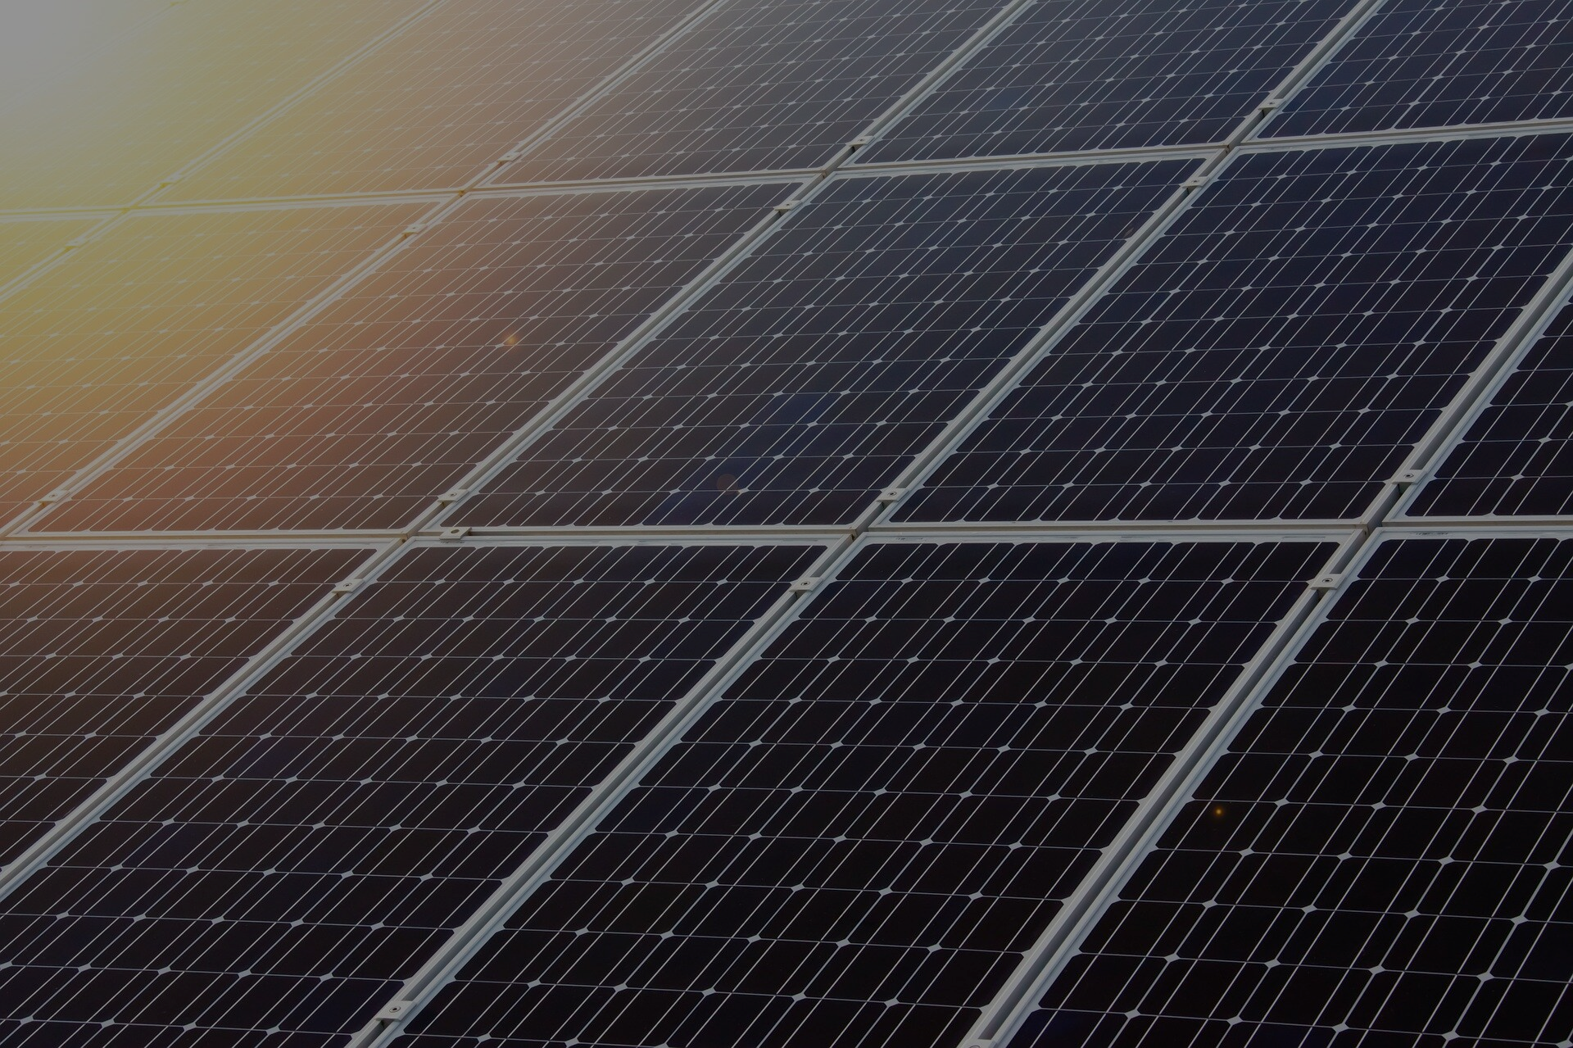
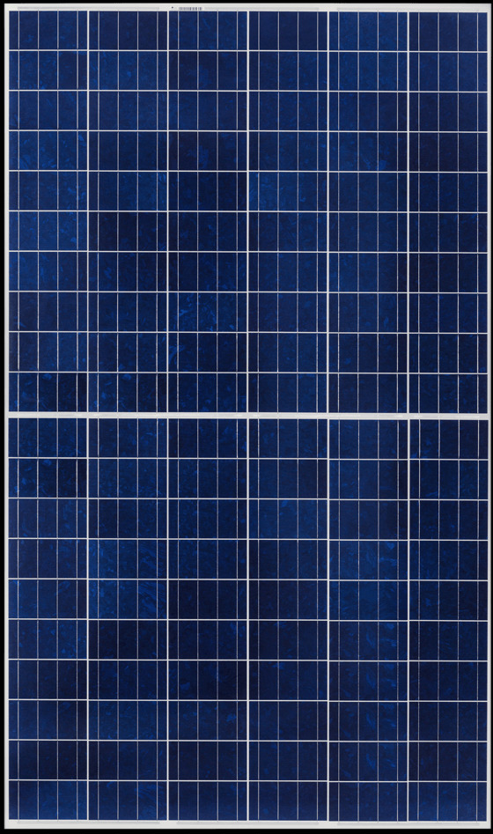
HARDWARE ON SOLAR PANEL
Water Jet
All Sensors
Water Jet
All the sensors will be kept in a box properly and will be mounted at the top of the solar panel in order to collect most accurate real time data.
Water jets and air blower will be mounted at upper corners of the solar panel so that it can reach every corner of solar panel for cleaning.
Air Blower
Air Blower

Slide 9
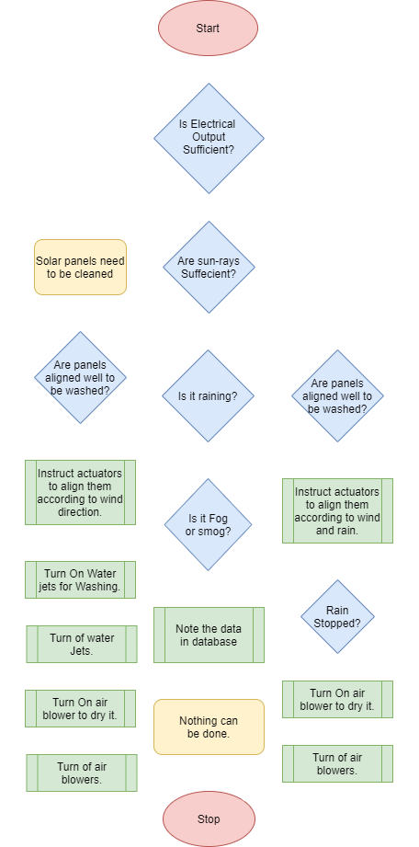
PROCESS OF HARDWARE
Hardware will be fully dependent on the instructions given by the Software.
Every crucial information from the sensor is used to optimize the output and cleaning process of the system.

